Slide 1



PIPELINE MANAGER
From Amshuhu iTech Solutions Pvt. Ltd.
Distributor Sales Representative
Version 1.0

Slide 2
Table of Contents
Distributor Sales Representative
Acronyms
Log in Screen
DSR Home Page
Existing Opportunities
My Reports
How to Use
Settings
Help
Log Off

Slide 3
ACRONYMS
Distributor Sales Representative
DGM→ Distributor General Manager
DSM→ Distributor Sales Manager
DSR→ Distributor Sales Representative
D-FLTS→ Distributor Field Lead Technical support
DMM→ Distributor Marketing Manager
SPANCOP→ Suspect, Prospect, Approach, Negotiate, Close, Order, Payment.
KPI→ Key Performance Indicator
CPT→ Coverage Penetration Throughput
OEM→ Own equipment manufacturers.
GKA→ Global Key Account
OWL→ Open, Won and Lost

Slide 4
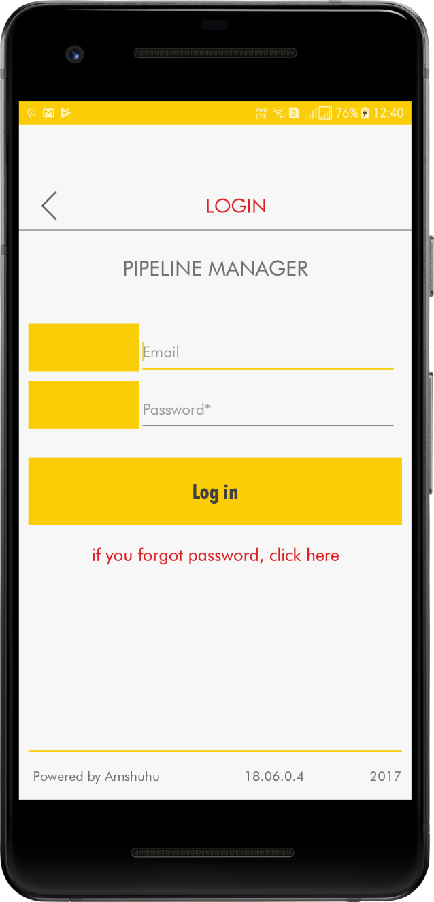
Login Screen In the Login screen by entering the User name and Password credentials you can gain access to the application.
Distributor Sales Representative

Slide 5
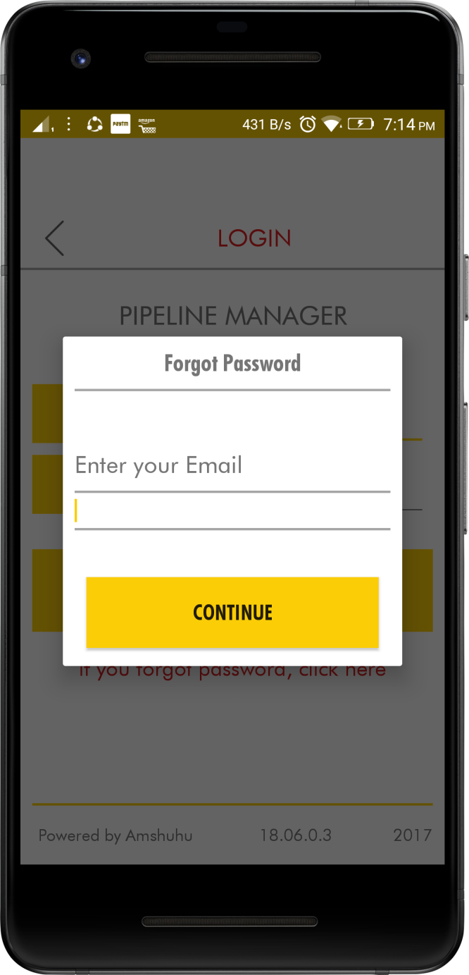
Distributor Sales Representative
If you forget your password, you can always click on the “if you forgot password, click here” link below the login button and follow the instructions to recover your password or get a new on

Slide 6
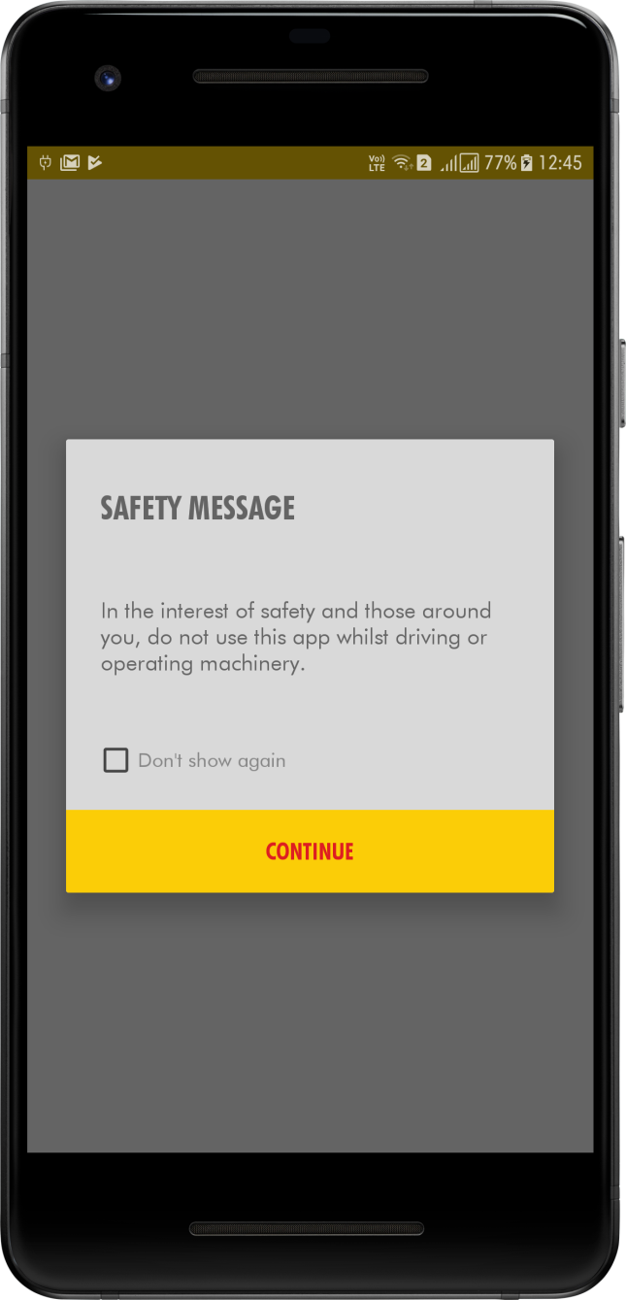
Distributor Sales Representative
In Safety measure screen click on the check mark and press Continue.

Slide 7
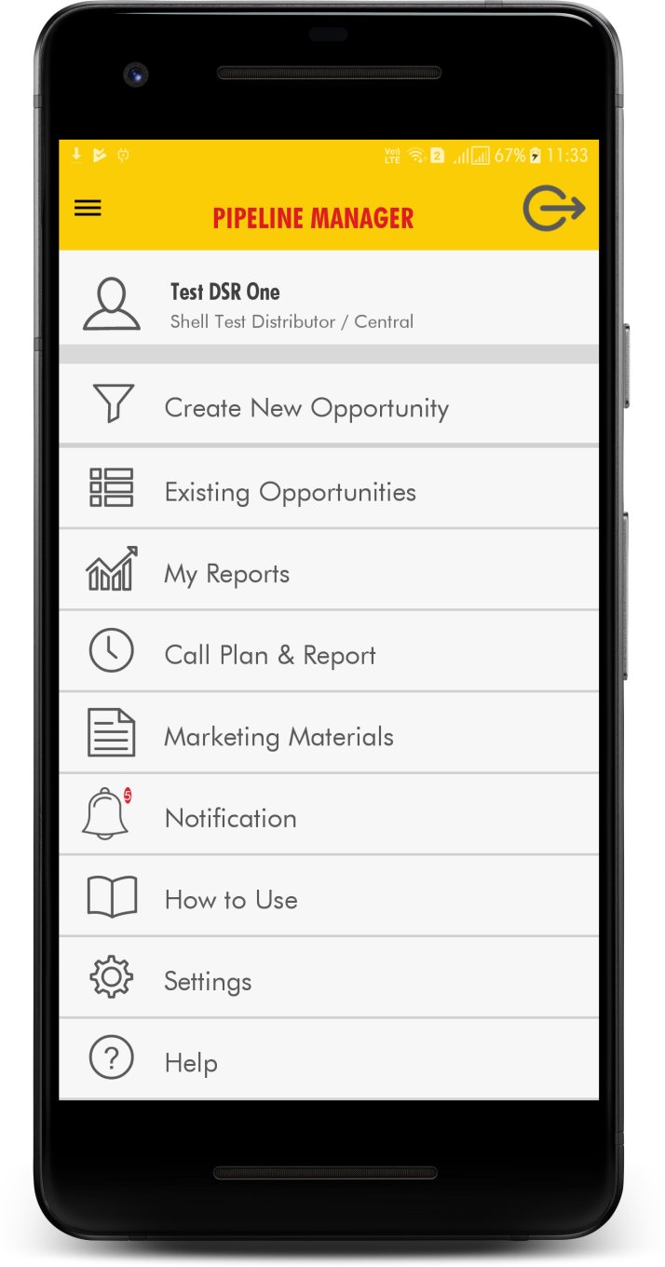
Distributor Sales Representative
DSR Home Page
Create> New Opportunity tab, allows the User to create a new lead.
Update> Existing Opportunity tab, allows the User to view and update an existing lead’s information.
All Opportunities tab, lists all the opportunities the User is responsible for.
My Reports tab, the user gets to view the status of users Annual Target and Pipeline strength.
How to use tab, takes the user to a users manual for the application.
Settings tab, allows the user manage the users profile and the mobile app notifications settings
Help
Log out tab, allows the user to Log out of the application.

Slide 8
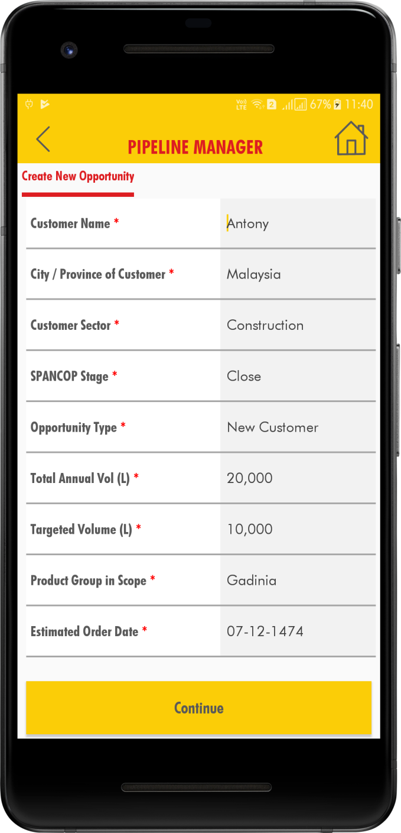
Distributor Sales Representative
Create New Opportunity
When clicked on the Create New Opportunity tab, the below screen appears allowing the user to enter the data for a new lead.

Slide 9
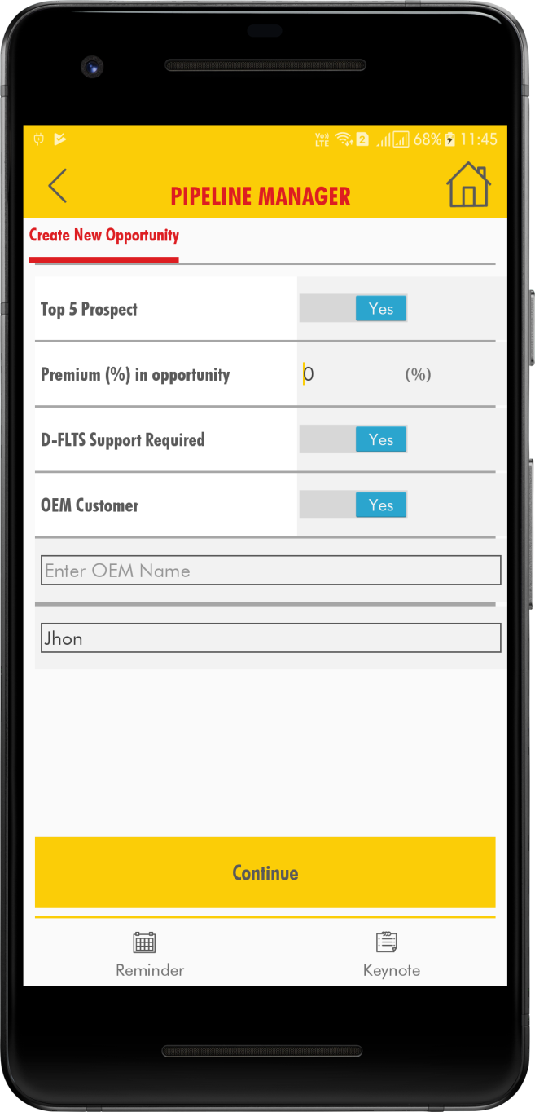
Distributor Sales Representative
After entering all the data, the new Opportunity is created for that particular DSR.

Slide 10
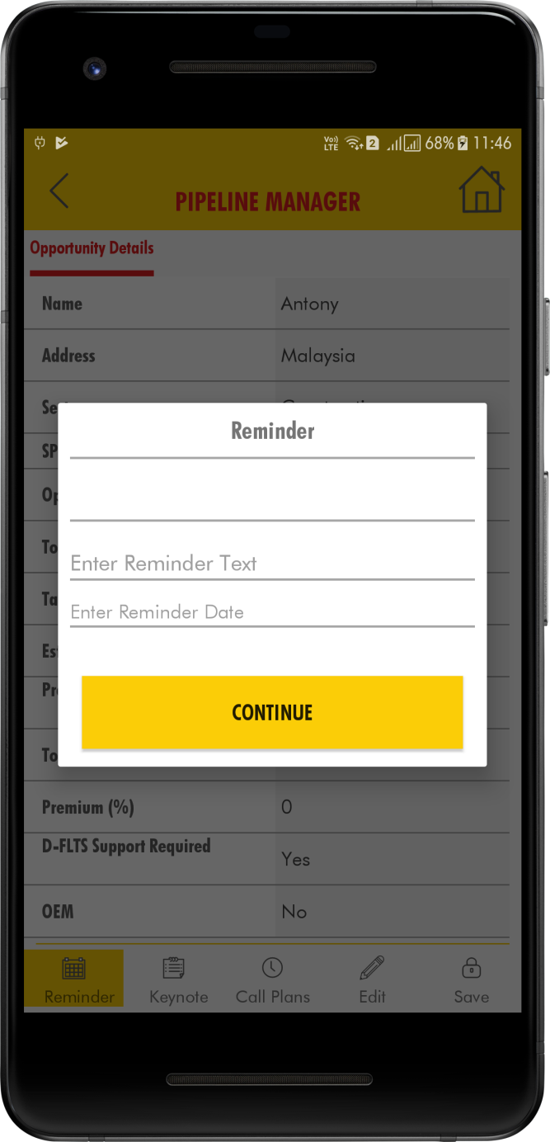
Distributor Sales Representative
Click on the Reminder. Pop up window appears with Date format.

Slide 11
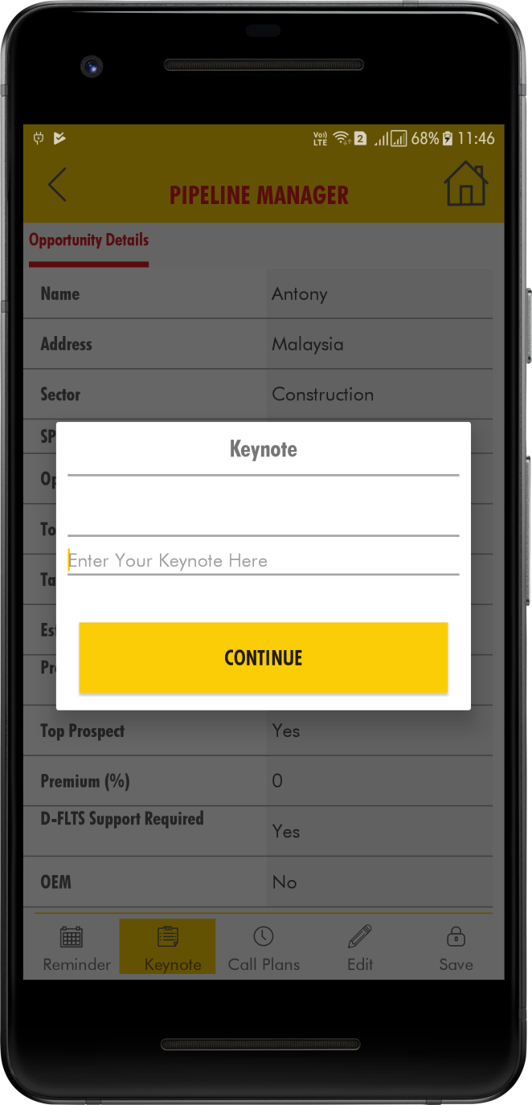
Distributor Sales Representative
Click on the Key Notes. Key Notes pop up window appeared enter the text and click on Continue.
After entering all the fields click the SAVE button.

Slide 12
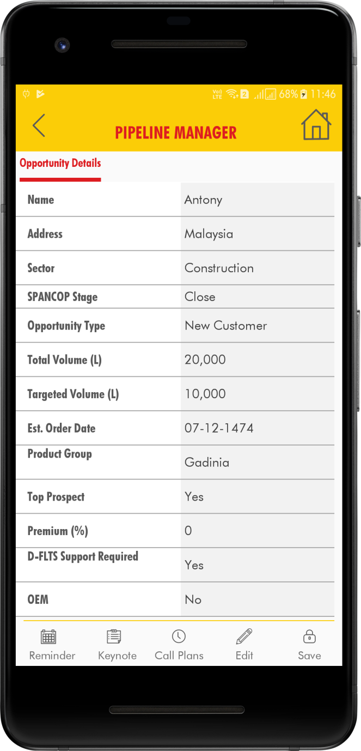
Distributor Sales Representative
After clicking the ‘SAVE’ button ‘Saved successfully’ message is appeared.

Slide 13
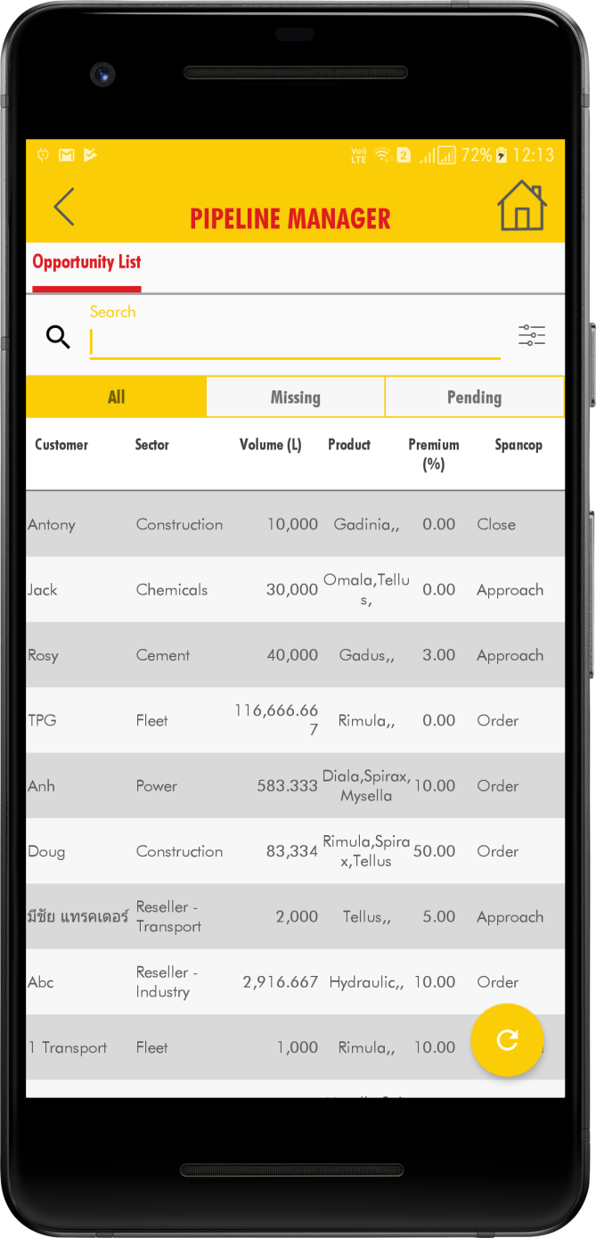
When clicked on the Update Existing Opportunity tab the below screen appears. In this view the list of all the opportunities that are under the responsibility of the logged in DSR are displayed. The DSR can select the Opportunity to edit by scrolling or using the search capability of the opportunities by clicking on the search button in the header. Filter option available to filter based on sectors currently.
Distributor Sales Representative
Existing Opportunities
All – List all opportunities.
Missing – List opportunities uploaded with missing data.
Pending – List opportunities uploaded by Shell through any campaign.

Slide 14
By clicking on the specific Opportunity, the DSR can view and update the details of that Opportunity.
Distributor Sales Representative

Slide 15
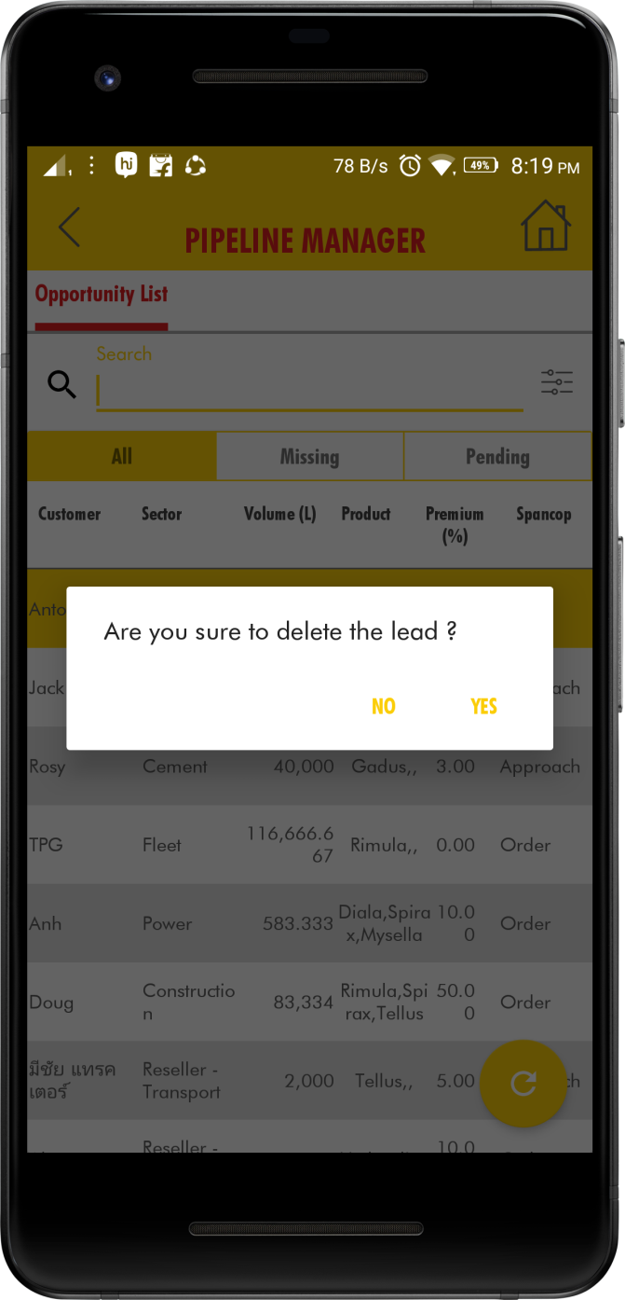
Distributor Sales Representative
If DSR wants to Delete the lead. The below pop up message is appeared after selecting the lead.

Slide 16
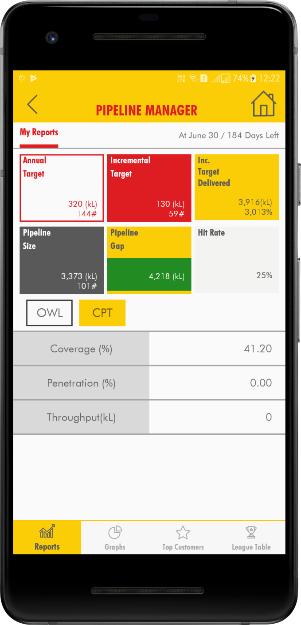
My Reports
Distributor Sales Representative
Pipeline manager handles new opportunity management. My Reports shows the DSR performance in details with Key parameters like Pipeline Size, Pipeline Gap and Hit Rate which will help and guide DSR to complete given target and improve the performance.
Annual Target:
Annual sales target agreed by DSR during yearly sales planning meeting in accordance with potential available. Set by DSM during the year both in terms of total volume and no of unique customers to be billed.
Incremental Target:
Sales volume expected from new customers / opportunities for this year considering, excluding retention sales from existing customers. Calculated by system based on last year sales volume, no of billed customers and expected churn rate. DSM need to entry information in the system

Slide 17

Distributor Sales Representative
Incremental Target Delivered:
Sales volume delivered from new opportunities till date. Calculated by system based on converted volume for opportunities in order and Payment stages.
Hit Rate:
Measure of DSR ability to convert sales from potential available for each.
Pipeline Size:
Total volume targeted for this year from identified new opportunities this year till now. New opportunities in Prospect, Approach, Negotiate and Closed stages will be considered for calculating pipeline size.
Pipeline Gap:
Main key parameter which will decide DSR target achievement ability for this year. DSR need to identify new opportunities to achieve this year target if there is any GAP.

Slide 18

Distributor Sales Representative
CPT:
Coverage Penetration and Throughput dashboard for DSR
Coverage:
Coverage will be measure to highlight no of customers identified / visited by the DSR based on the his universe.
Penetration:
No of customer billed during period based on his universe.
Throughput :
Average volume billed per customers

Slide 19
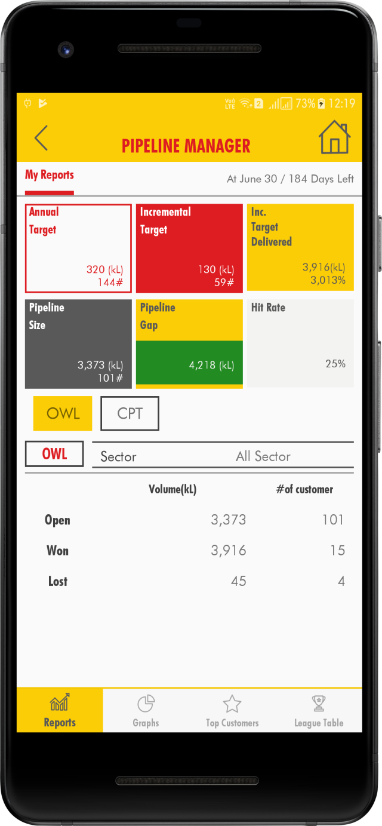
Distributor Sales Representative
OWL :
Open, Win and Lost dashboard will high DSR performance.
Open:
New opportunities which are in stages like Prospect, Approach, Negotiate and Close stages.
Win:
Total new opportunities billed during these period. We consider Order and Payment stages.
Lost:
New opportunities which are not converted. DSR need to change the status to lost for the lost opportunities.

Slide 20
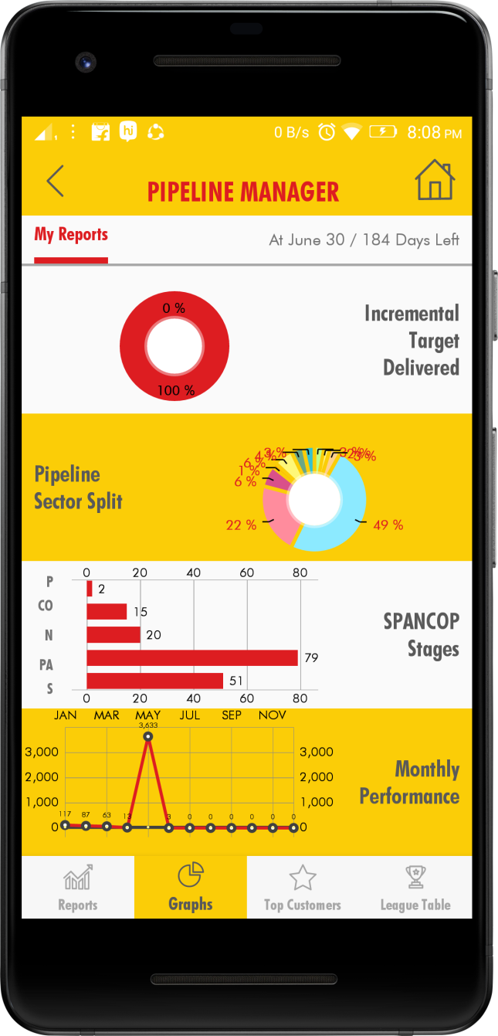
Incremental Target Delivered: Graphical representation for new opportunities sales volume billed till now. Pipeline Sector Split: New opportunities which are all in different sectors like General Manufacturing, Fleet, Mining etc. SPANCOP Stages: View of new opportunities in different stages like Suspect, Prospect, Approach, Negotiate, Closed, Order and Payment. Monthly Performance: New opportunities which are converted in different months, this provide graphical view on month wise conversion.
Distributor Sales Representative

Slide 21
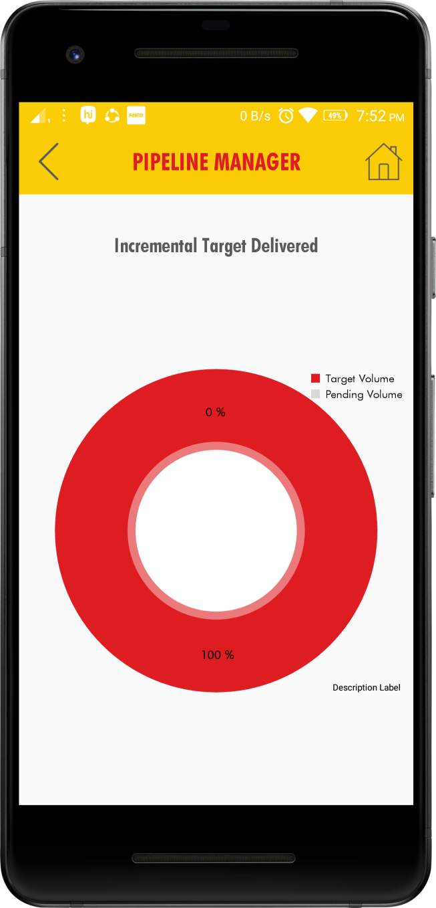
Distributor Sales Representative
Incremental Target Delivered:
Graphical representation for new opportunities sales volume billed till now.

Slide 22
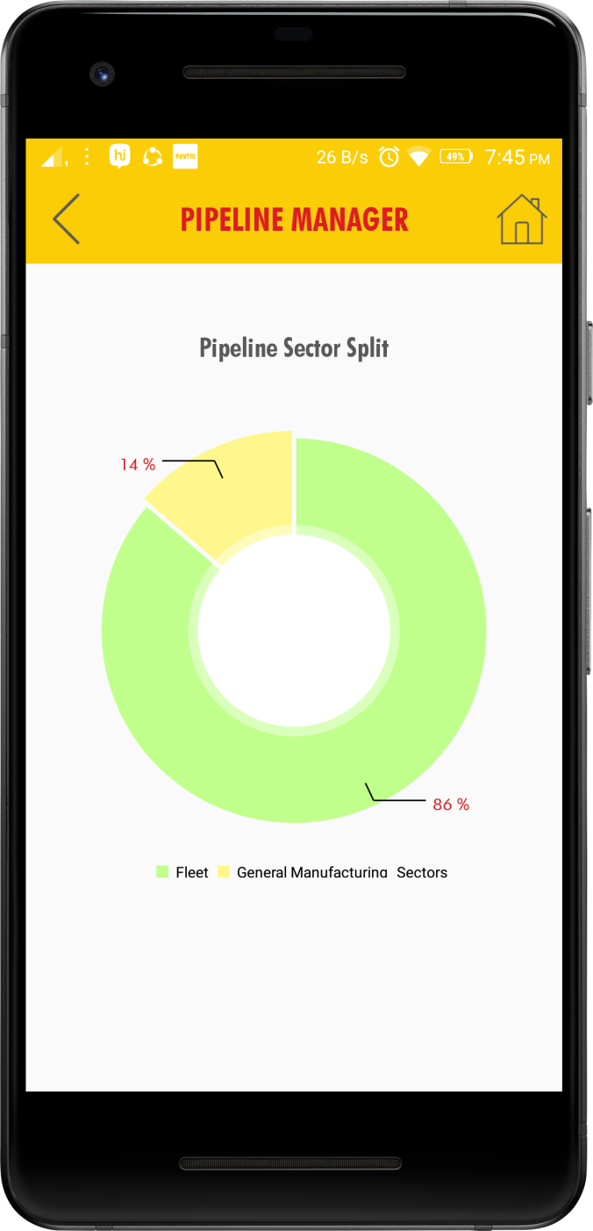
Distributor Sales Representative
Pipeline Sector Split: New opportunities which are all in different sectors like General Manufacturing, Fleet, Mining etc.

Slide 23
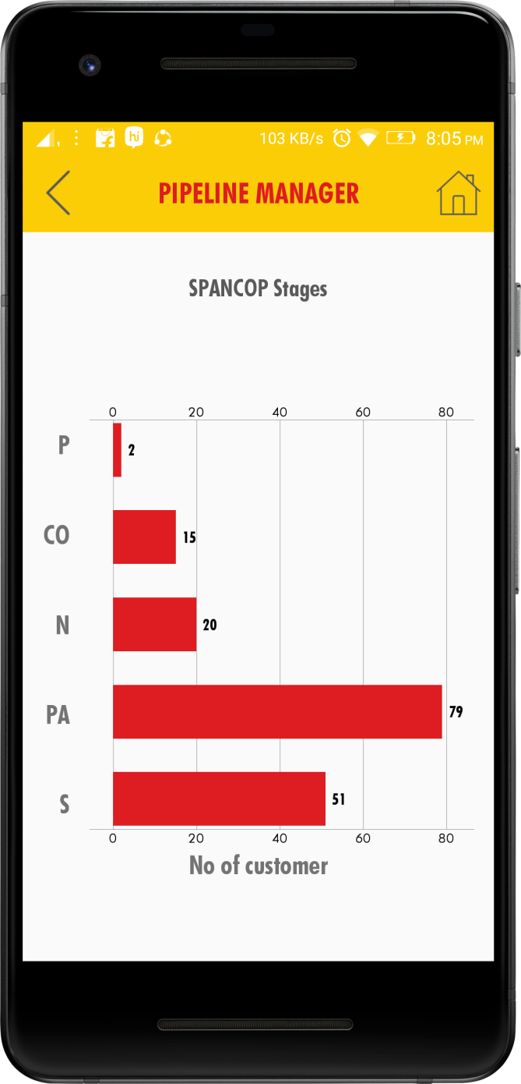
Distributor Sales Representative
SPANCOP Stages: View of new opportunities in different stages like Suspect, Prospect, Approach, Negotiate, Closed, Order and Payment.

Slide 24
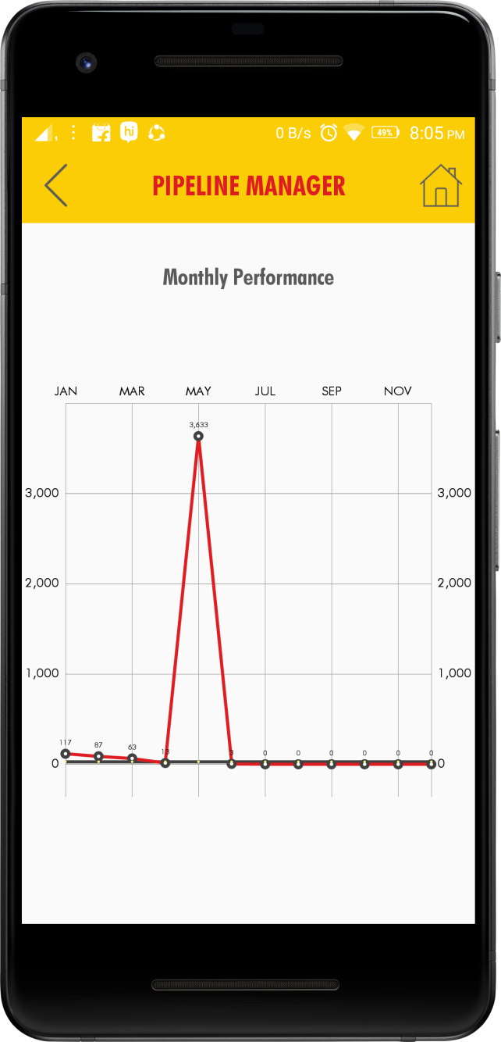
Distributor Sales Representative
Monthly Performance: New opportunities which are converted in different months, this provide graphical view on month wise conversion.

Slide 25
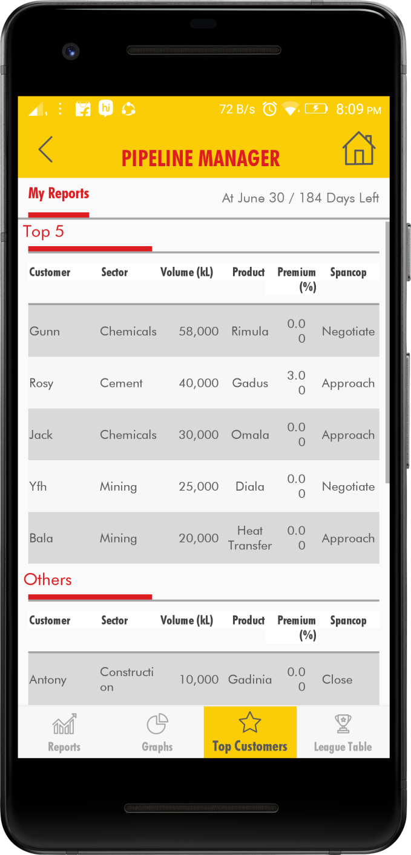
Top Customer It is ready reference to review the top customers of the DSR. By tap on customer you can view the details
Distributor Sales Representative

Slide 26
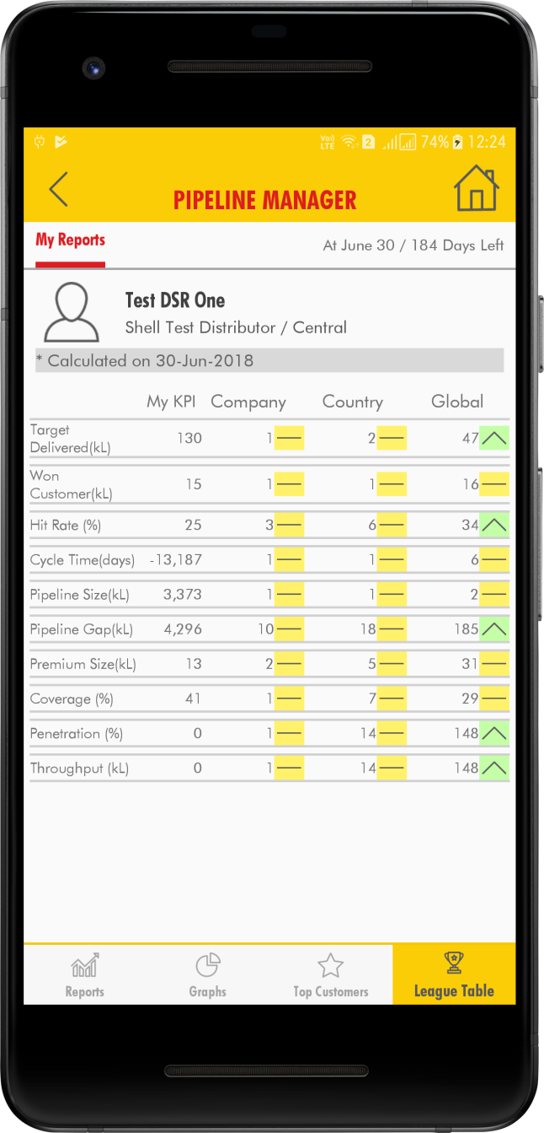
League Table: Gamification of key performance indicators for DSR , which will help DSR to compete and improve the performance with in organization, country and Global. We use only the aggregated value to no details will be used.
Distributor Sales Representative

Slide 27
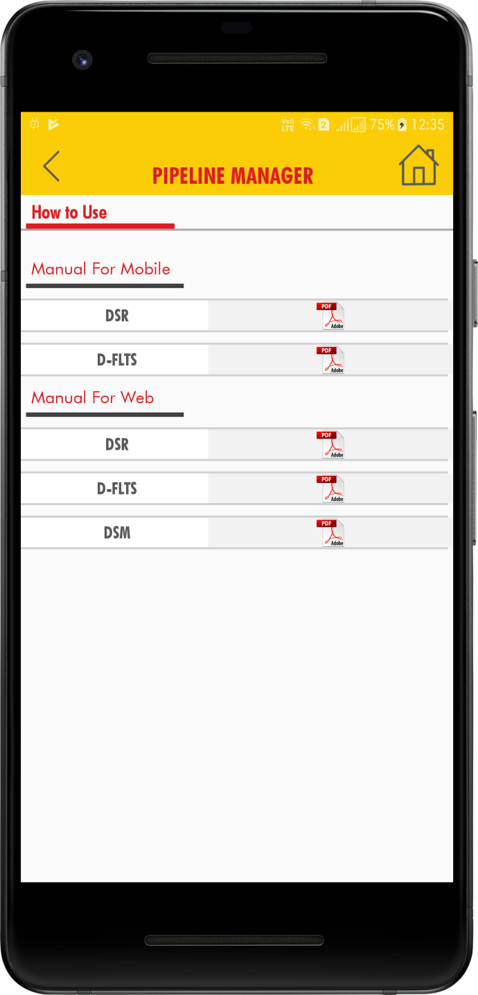
How To Use
Distributor Sales Representative
After clicking on the How To Use tab, the below screen is displayed with Manuals in PDF Format.

Slide 28
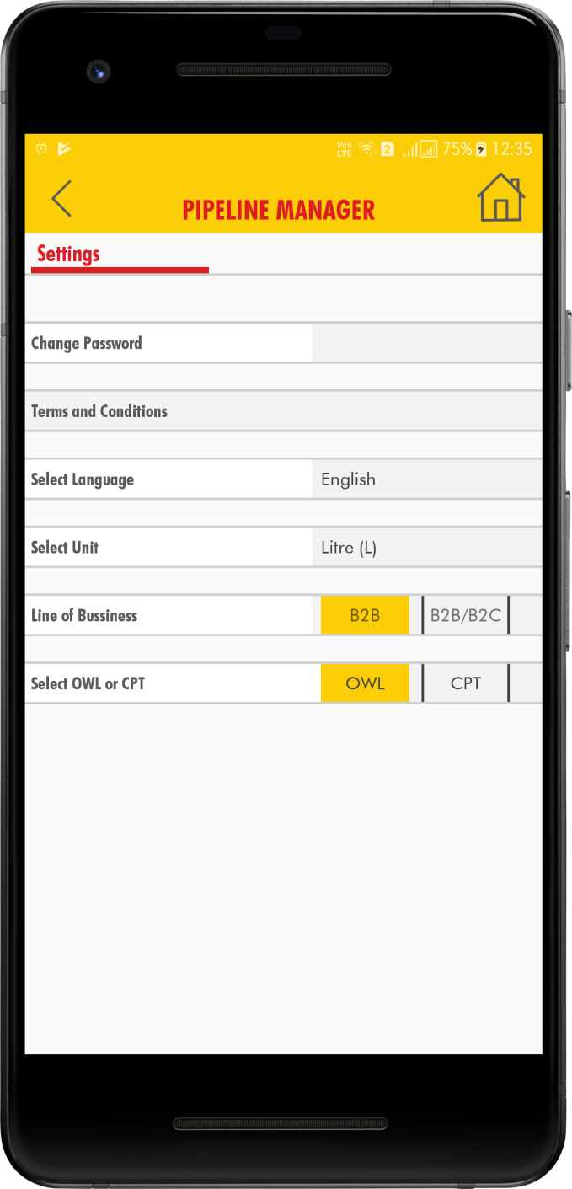
Settings
Distributor Sales Representative
After clicking on the Settings tab, the below screen is displayed with Select Language, Select Unit and Change Password.

Slide 29
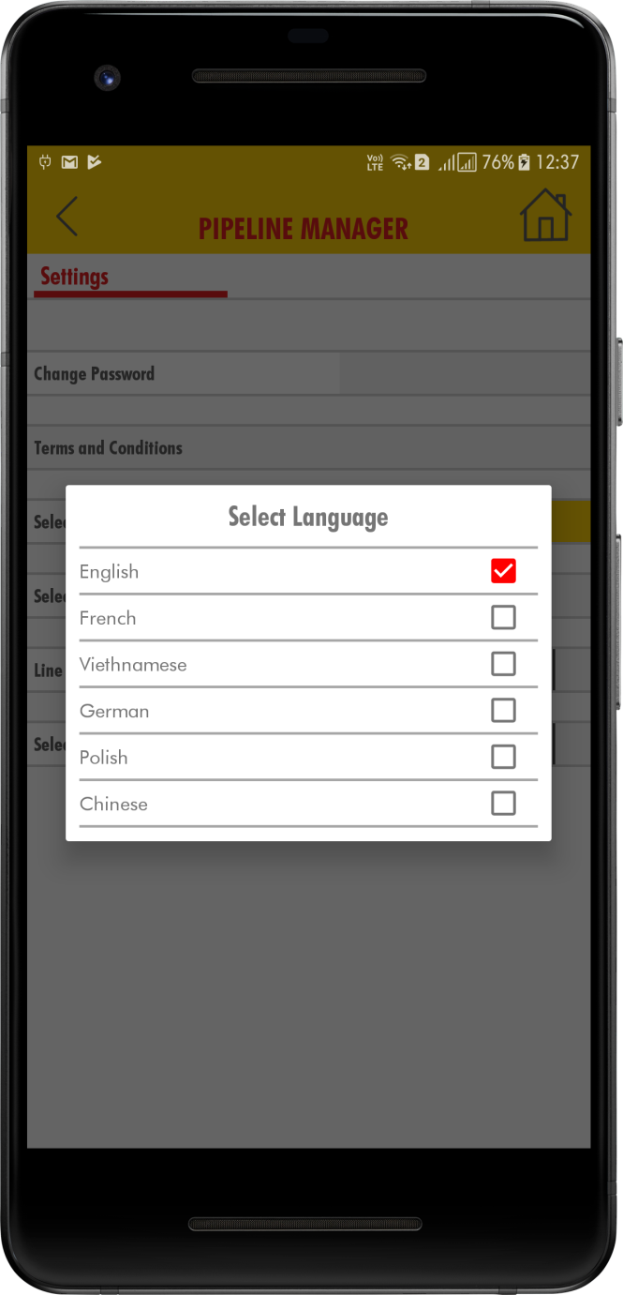
Click on the Select Language, the pop up window is appeared with different languages. Then we can the select language.
Distributor Sales Representative

Slide 30
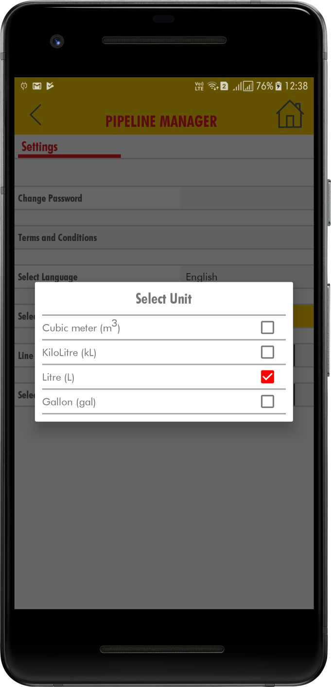
Click on the Select Unit, the pop up window is appeared with different Units. In that we can select the Units Cubic meter or Kilo Litre.
Distributor Sales Representative

Slide 31
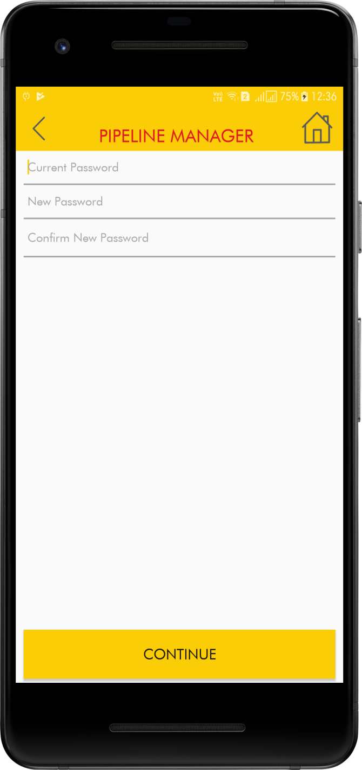
Distributor Sales Representative
Click on the Change Password, the below screen displayed with Current Password and New Password. After entering all the fields click on Continue button. Password changed successfully message appeared.

Slide 32
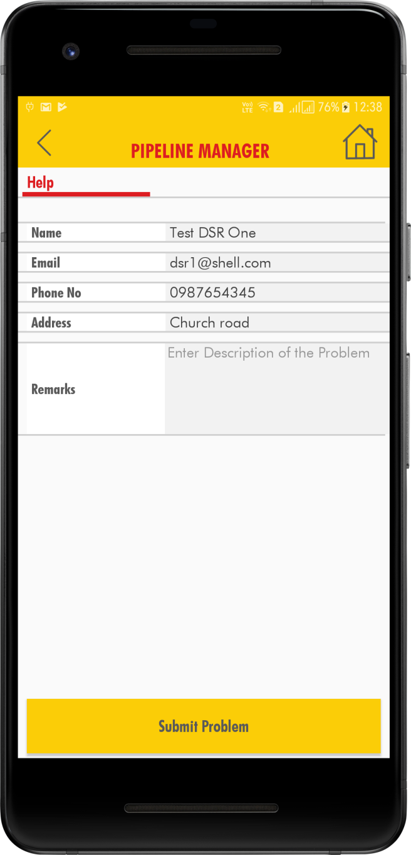
Help
Distributor Sales Representative
After clicking on the Help tab, the below screen is displayed with Name, Email , Phone No, Address and Remarks.

Slide 33
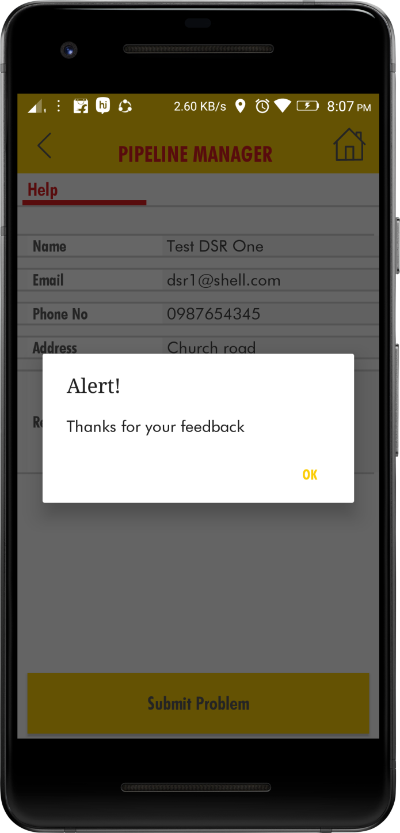
After entering the Remarks click on the Submit Problem. The below screen is appeared with alert message.
Distributor Sales Representative

Slide 34
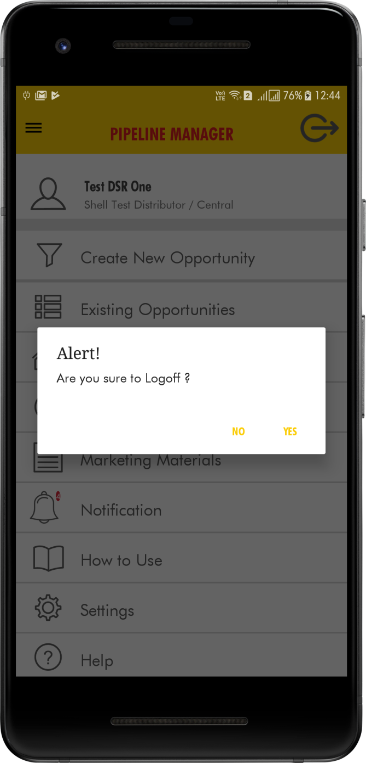
Log Off
Distributor Sales Representative
Click on the Logoff icon on the top right corner of the home page .And confirm the popup message which is shown like “Are you sure to Logoff”.

